Slide 1



Advanced Stock Prediction System
Using Machine Learning Algorithms

Slide 2


Intoduction
Abstract
Introduction
Future of Technology
The limitation of the proposed model is the computational speed, as the computational cost increases with the number of forward-day predictions.
The model does not predict well for sudden changes in the trend of stock data.
We can modify this System to an online learning system which can learn in real time.
The proposed model compares different machine learning algorithms to predict the stock prices of a company. The model is trained and given testing data and the result is compared for the most accurate result which can help guide investors' decisions.
The financial market is highly volatile and generates huge amounts of data on a daily basis.
Stock prices are predicted to determine the future value of the company's stock or other financial instruments.
Machine learning models can provide accurate predictions which can lead to a better planning and growth of the company

Slide 3
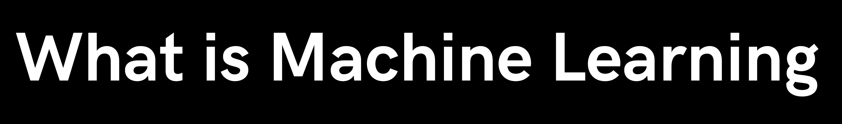



Machine Learning is the field of study which provides the computer with the ability to learn without being explicitly programmed.
Machine learning model
Machine learning models are computer programs that are used to recognize patterns in data or make predictions. Machine learning models are created from machine learning algorithms, which are trained using either labeled, unlabeled, or mixed data.
Models used to compare in our model are Support Vector Regression (SVR)
K Nearest Neighbour (KNN) Gated recurrent Unit (GRU)
Long Short-Term Memory (LSTM) Random Forest

Slide 4





Machine Learning Models
Support Vector Regression:
SVR can be used to predict the future price of a stock based on historical price and volume data, as well as other relevant factors such as news articles, financial statements, and economic indicators. It finds a hyperplane that best fits the data points in a continuous space, instead of fitting a line to the data points
K Nearest Neighbour
This algorithm makes predictions based on the similarity between the new data point and the existing data points in the training set.
Gated Recurrent Unit
It is a type of recurrent neural network (RNN) architecture that can also be used for stock prediction. Start by collecting historical data on the stock you are interested in, as well as any relevant external factors. You would then preprocess and clean the data and split it into training and testing sets.

Slide 5




Machine Learning Models
Long Short -Term Memory
LSTM can by default retain the information for a long period of time. It is used for processing, predicting, and classifying on the basis of time-series data. Gated cells hold internal variables, LSTMs address this problem by introducing a memory cell, which is a container that can hold information for an extended period of time.
Random Forest
It is an ensemble learning method that builds multiple decision trees and combines their predictions to produce a final output. Each decision tree in the random forest is trained on a randomly selected subset of the training data, and the trees are trained independently of each other. The final output of the random forest is typically the average (or weighted average) of the predictions of the individual trees.

Slide 6

Existing Methods
Support Vector Regression is typically used to solve non-linear regression problems by constructing an Input-output mapping function.
Least square support vector regression is a further development of SVR and its use considerably reduces computational complexity and increases efficiency compared to standard SVR.
Disadvantages
The existing systems do not generalize for the markets worldwide. The systems do not allow for the import of raw data directly
Data quality: Stock market data is often noisy and can contain errors, missing values, and outliers.
Market unpredictability: The stock market can be unpredictable, and unexpected events can cause sudden and significant changes in stock prices.

Slide 7
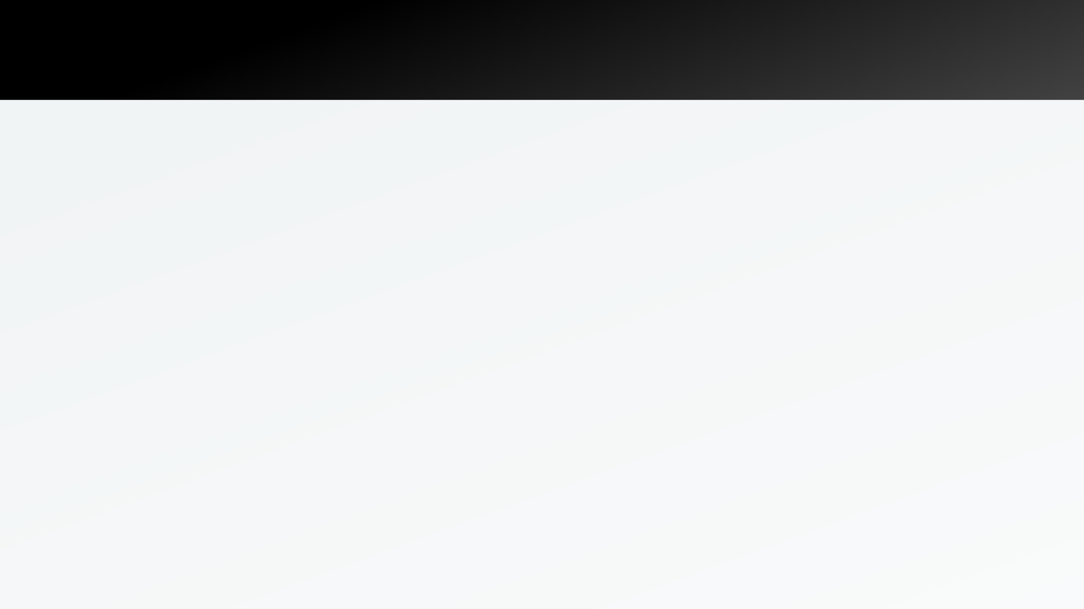


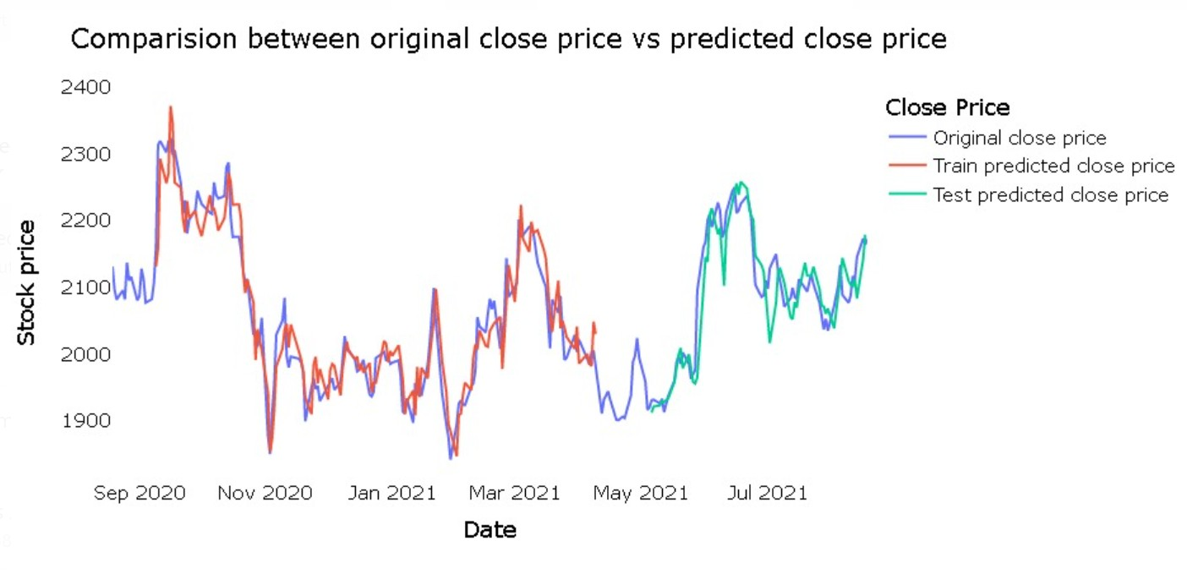

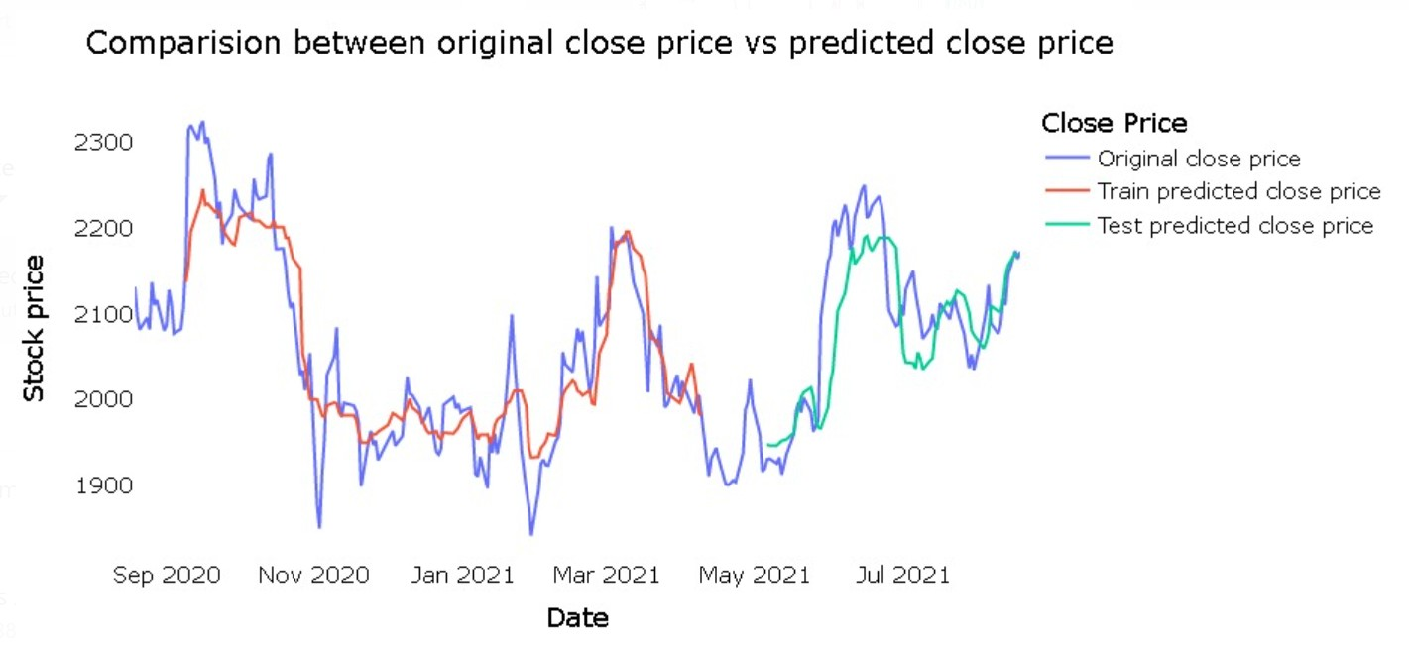
PREDICTION
Support Vector Regression
Mission
K Nearest Neighbour Prediction

Slide 8


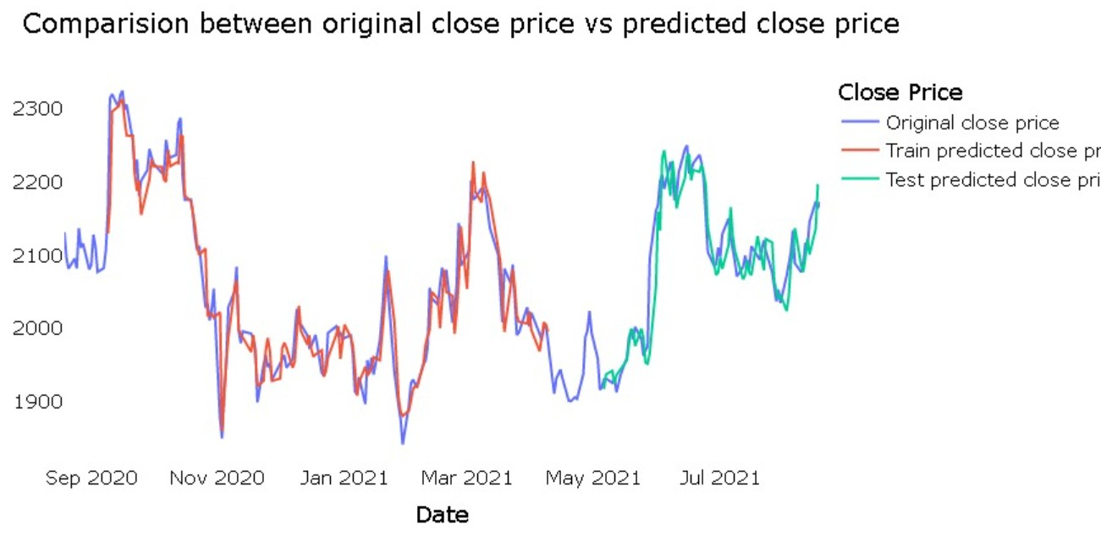
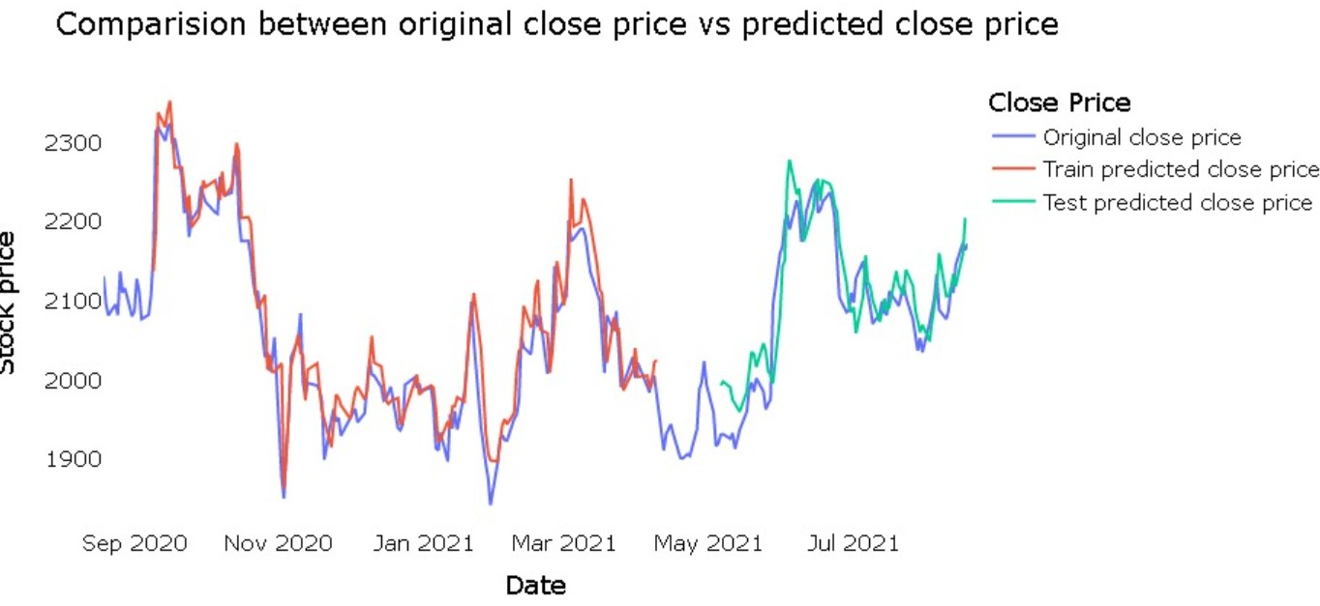
PREDICTION
Gated Recurrent Unit
Longest short Term Memory

Slide 9
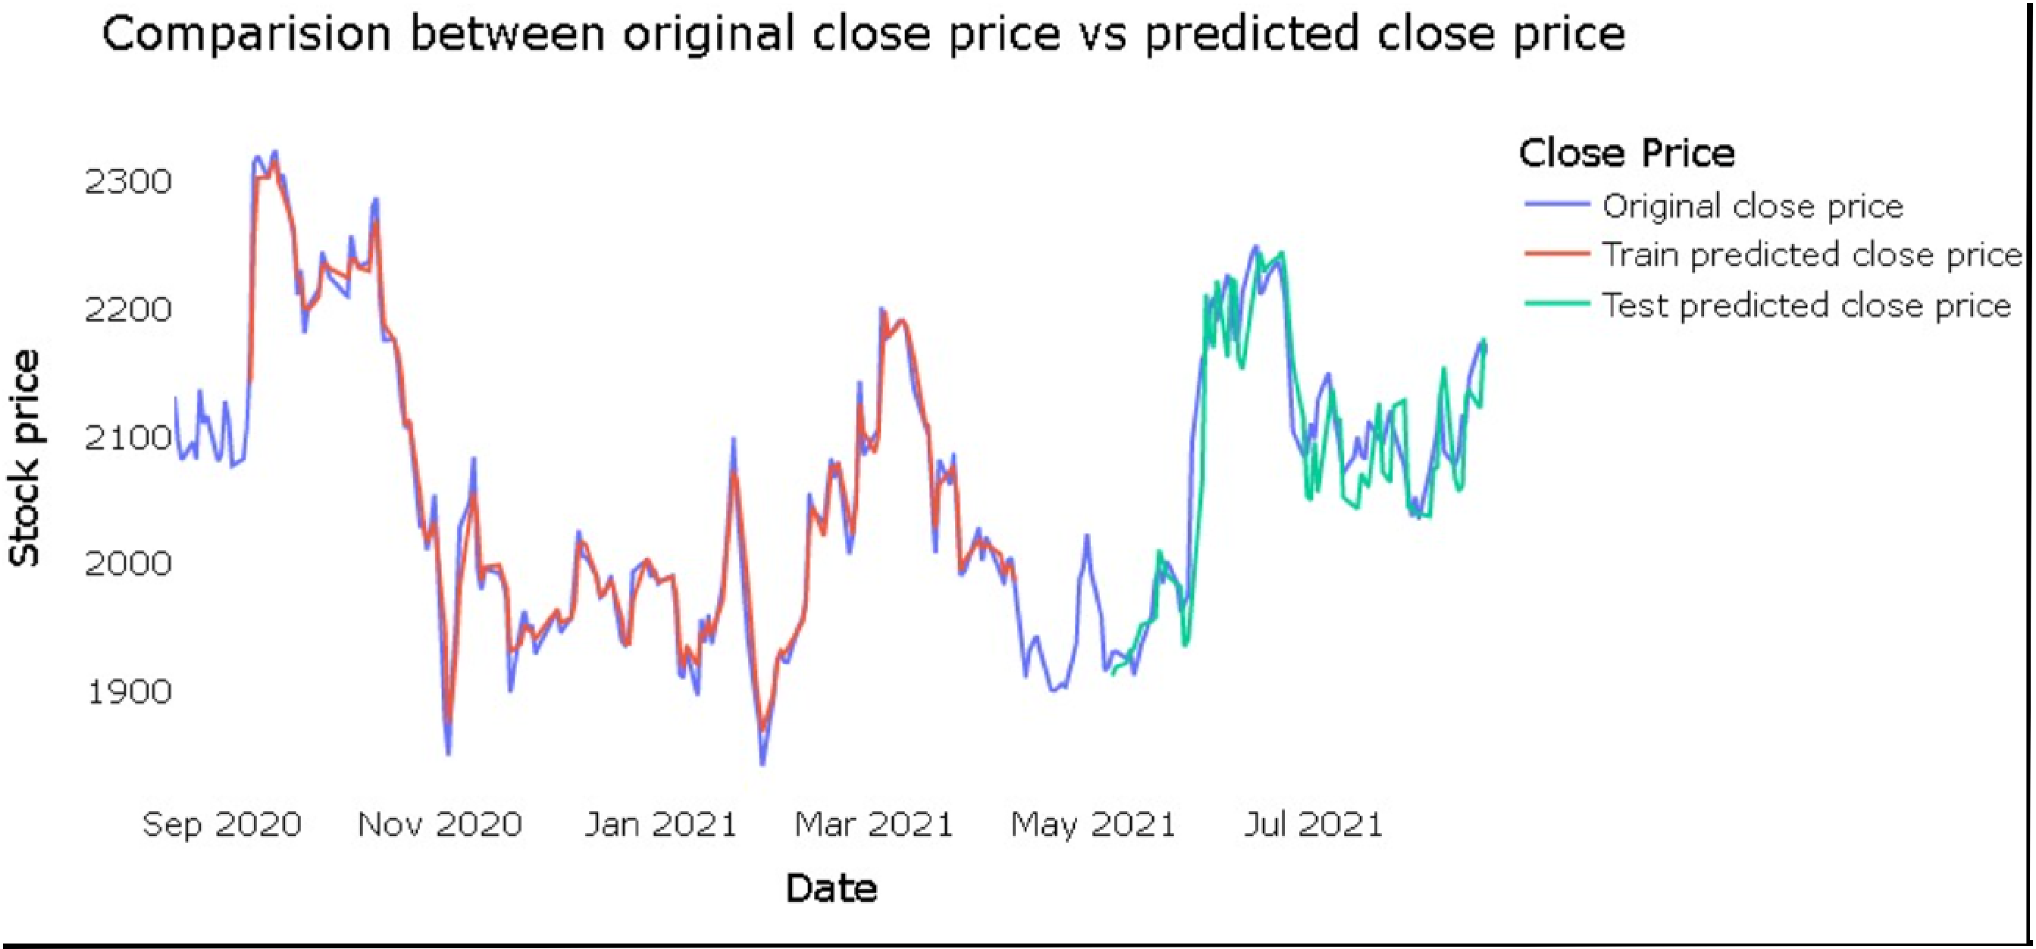
PREDICTION
Random Forest

Slide 10
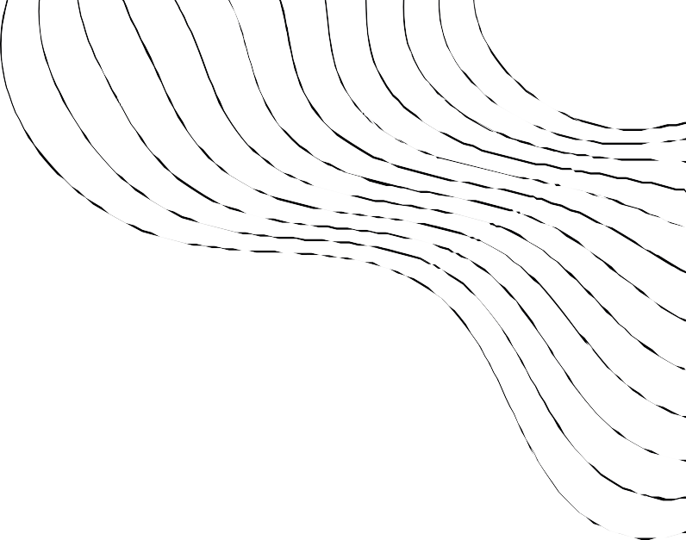
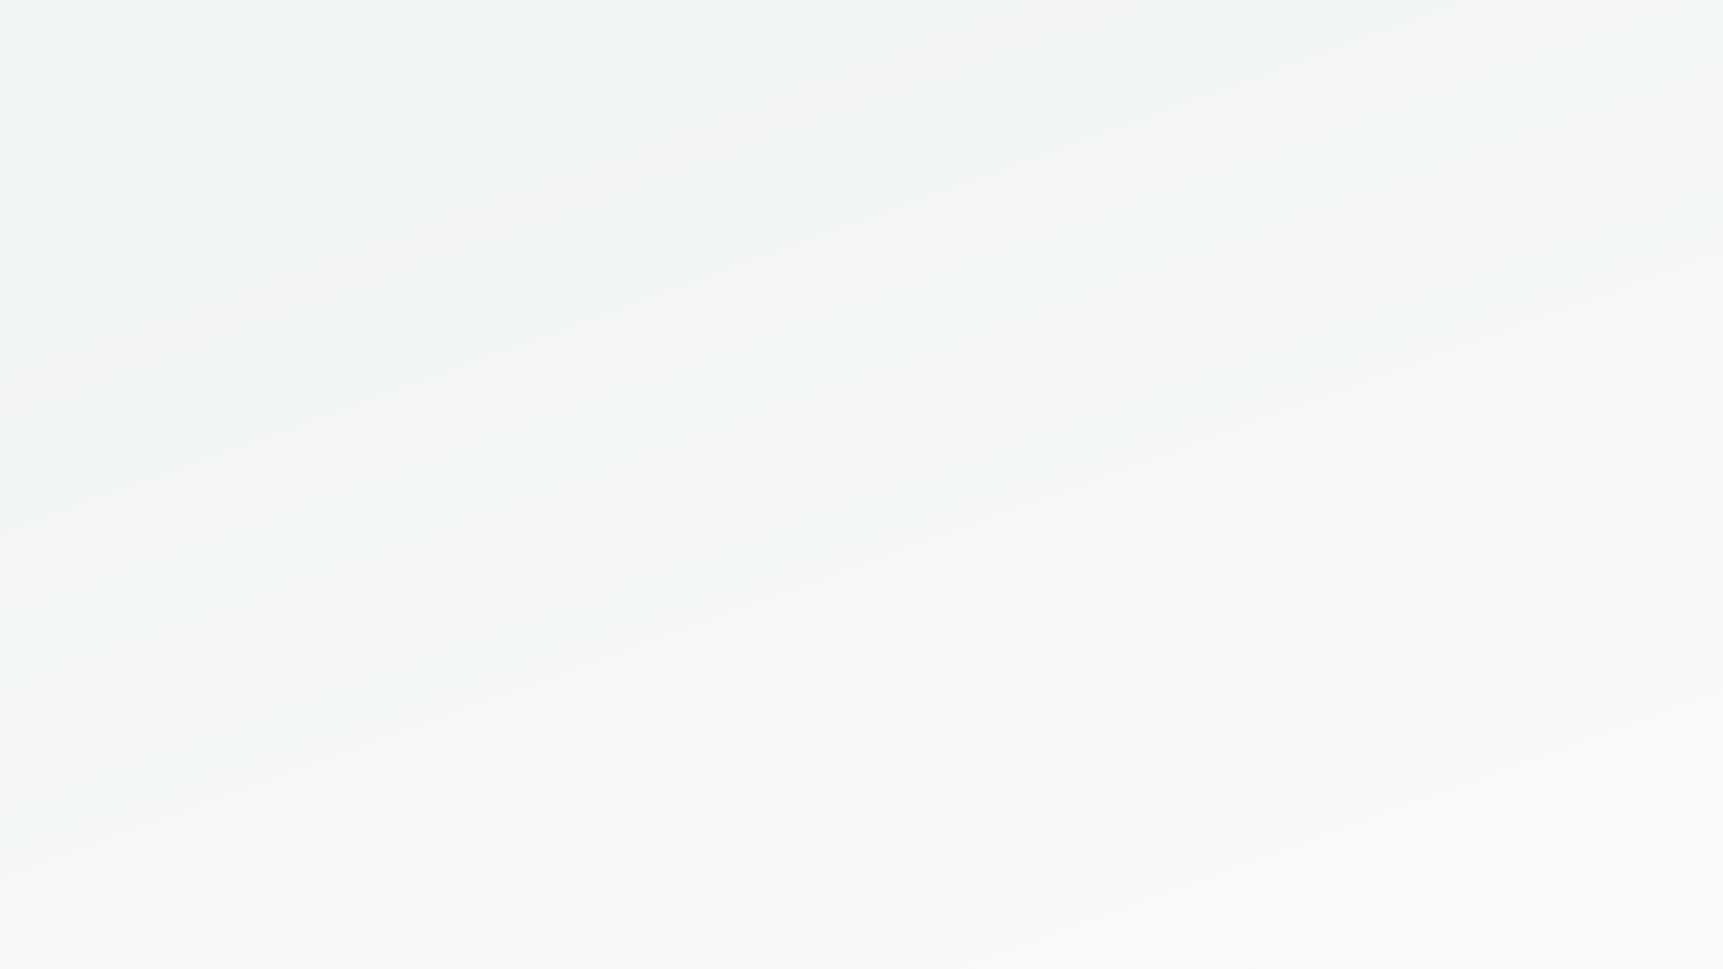

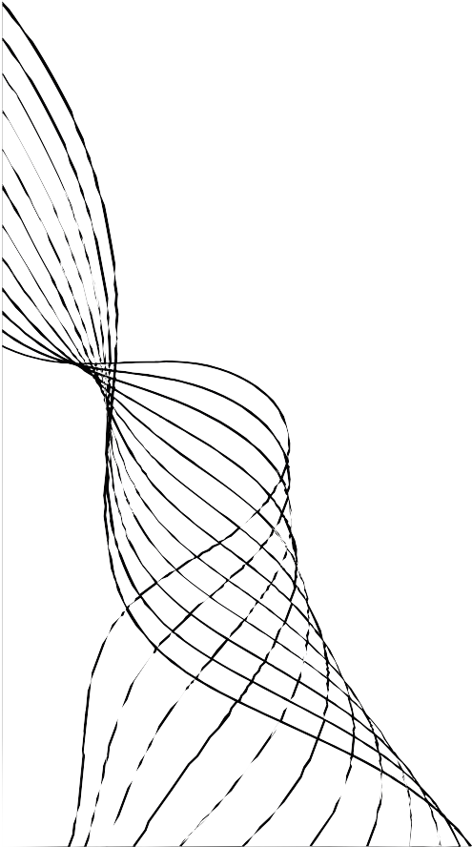
PROPOSED MODEL
Our Version
Longest Short-Term Memory
+
Gated Recurrent Unit
Constraints
We use a hybrid of two
I t' s important to note that while machine
learning can be a powerful tool for
stock prediction, it' s not a silver bullet and there are inherent
l imitations and risks associated with using
any prediction model.
models that is:
LSTM+GRU. These are
recurrent neural networks that are well-suited for
modelling sequential data l ike stock prices and can capture long-term
dependencies and non-
l inear relationships between the input features and the
target variable.

Slide 11


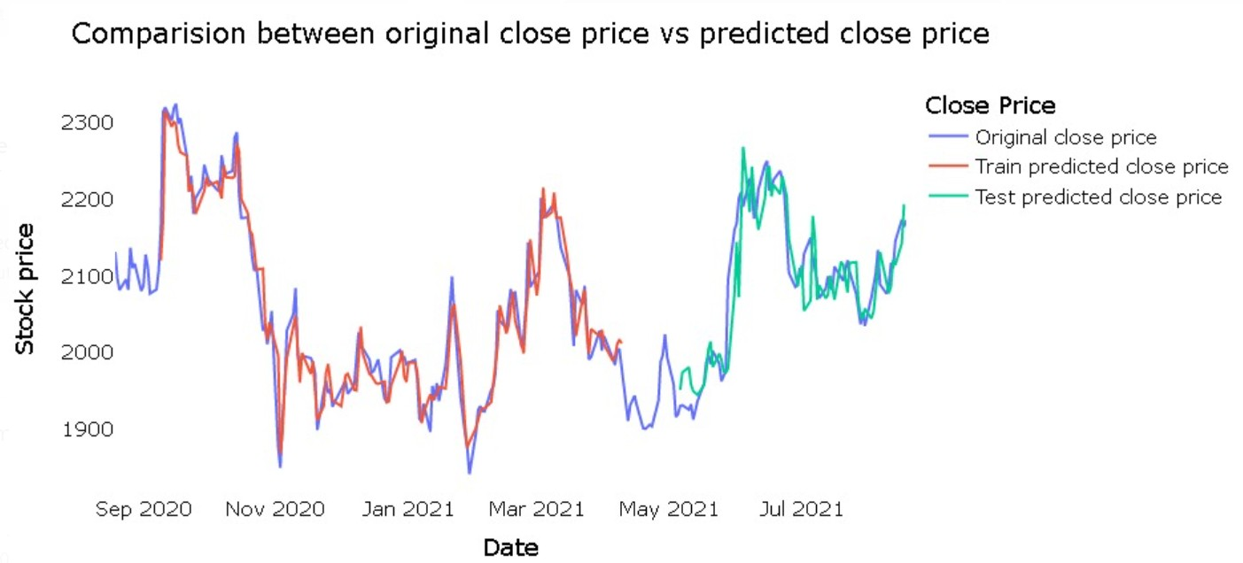
PREDICTION
Longest short term memory+ Gated recuurent Uinit

Slide 12
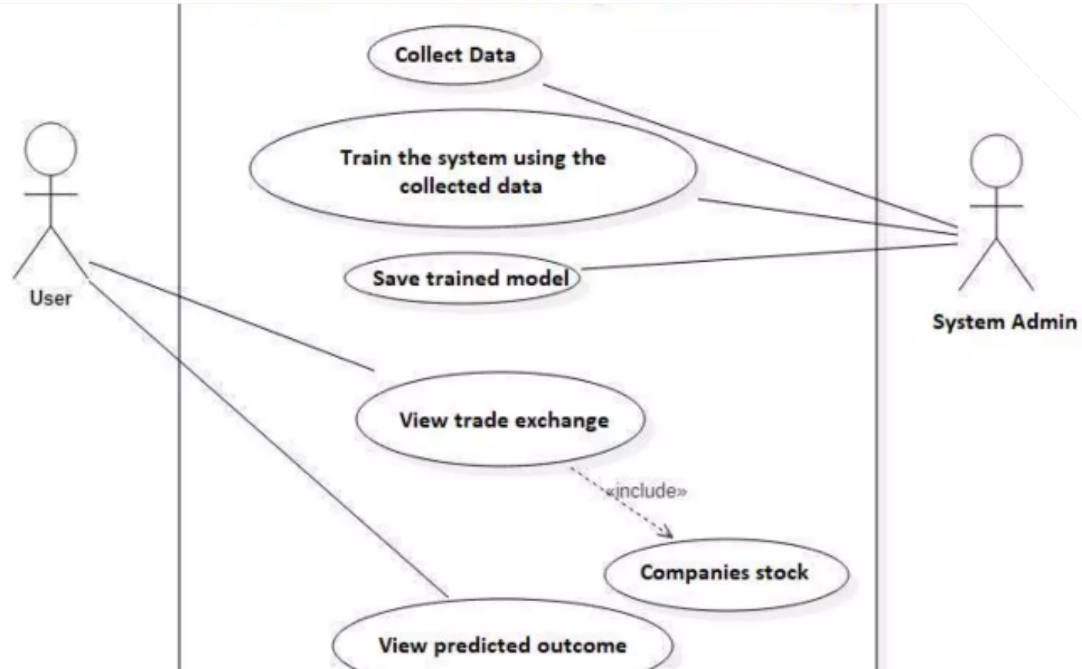
SYSTEM DESIGN
Data is firstly collected online or stock exchange
Data is used to train the system The trained model is saved
User views the trade exchange and
stock of a company
Using the model, closing price is predicted.

Slide 13
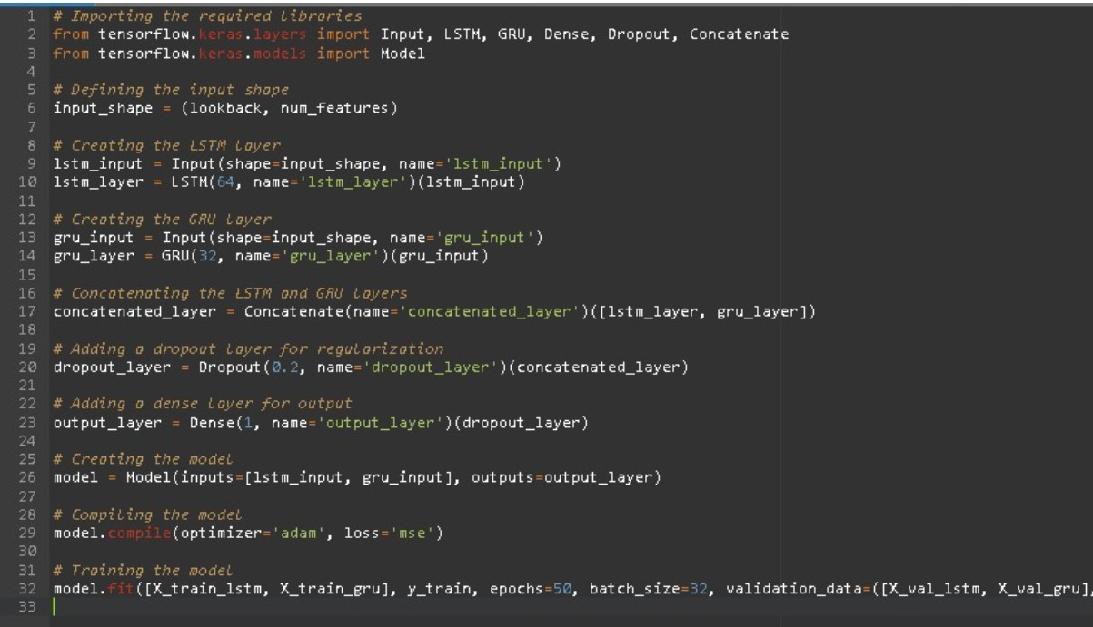
Pseudocode and working
In this pseudocode example, we are creating a neural
network architecture that consists of two inputs, one for the LSTM layer and one for the GRU layer. The output of each layer is then concatenated using the Concatenate layer, and a dropout layer is added for regularization. Finally, a dense layer is used to produce the output. The
model is then compiled and trained using the training data. This architecture can be adjusted and tuned based on the specific requirements of the stock prediction problem.

Slide 14
Comparison of all algorithms

Slide 15
CONCLUSION
Determining the best methodology for an advanced stock prediction system is a complex task that depends on several factors, including the specific characteristics of the financial data being used, the specific goals of the prediction task, and the available resources for implementation.
One approach to determining the best methodology is to compare the performance of several different machine learning algorithms on the same dataset using appropriate evaluation metrics, such as mean absolute error (MAE), root means squared error (RMSE), and mean absolute percentage error (MAPE). This can help identify which algorithms are most effective at predicting stock prices for the specific dataset and prediction task.
LSTM+GRU models are often more accurate for stock prediction than traditional machine learning algorithms like SVR, RF, and KNN because they are specifically designed to handle sequential data, are flexible and adaptable, can capture non-linear relationships, and can handle large amounts of data. However, it is important to note that the accuracy of any stock prediction model will depend on the quality and relevance of the input features, the amount and quality of the historical data, and the volatility of the financial markets.

